Slide 1
Github Repository Demo

Slide 2
Github Repository
https://github.com/Team-3-MarketplaceSolution/DonationPlaceSolution

Slide 3
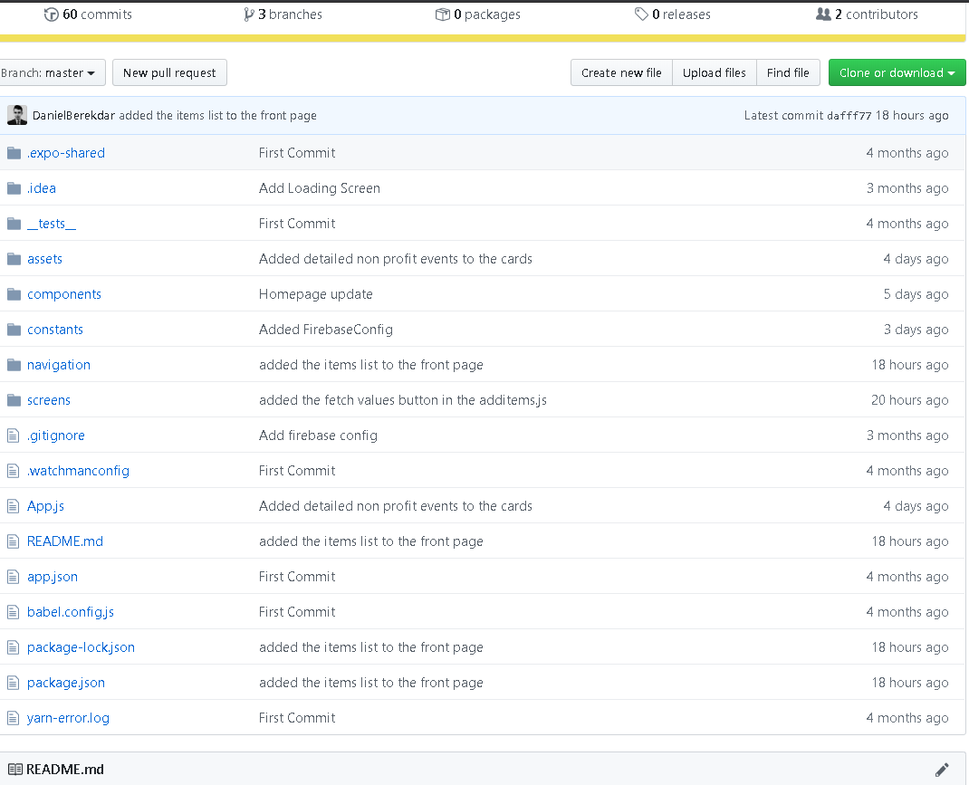

Slide 4
4.1 Leave a Message
import React, {Component} from 'react';
import {View, Text, TextInput, TouchableOpacity, StyleSheet, Button, Image, ScrollView} from 'react-native';
import email from 'react-native-email'
import SubmitButton from "../components/SubmitButton";
import Icon from "react-native-vector-icons/FontAwesome5";
import {
Container,
List,
Content,
ListItem,
Card,
CardItem,
Thumbnail,
Badge,
Right,
Body,
Left
} from "native-base";
import Colors from "../constants/Colors";
export default class LeaveMessageScreen extends React.Component {
state = {
email: 'support@donationplacesolution.com',
subject: '',
body: '',
}
render() {
return (
<ScrollView>
<View style={styles.container}>
<Card style={styles.card}>
<Text style={styles.title}>To: </Text>
<Text>{this.state.email}</Text>
<Text style={styles.title}>Subject: </Text>
<TextInput
// style={styles.textInput}
autoCapitalize="none"
placeholder="Subject"
onChangeText={subject => this.setState({subject})}
value={this.state.subject}
/>
<Text style={styles.title}>Your Message: </Text>
<View style={styles.messageBody}>
<TextInput multiline
// style={styles.messageBody}
autoCapitalize="none"
placeholder="Your Message"
onChangeText={body => this.setState({body})}
value={this.state.body}
/>
</View>
</Card>
<SubmitButton click={this.handleEmail}>Leave Message</SubmitButton>
<View>
<Text style={{padding: 20, marginTop: 20, fontWeight: 'bold', fontSize: 20, textAlign: 'center'}}>Contact
US</Text>
<Text style={styles.title2}>Get Information:</Text>
<Text>info@donationplacesolution.com</Text>
<Text style={styles.title2}>Press or media request:</Text>
<Text>press@donationplacesolution.com</Text>
</View>
<View style={styles.footerContainer}>
<Text style={{padding: 20, marginTop: 10, color: 'white', fontWeight: 'bold', fontSize: 20,}}>Follow
Us On</Text>
<View style={styles.iconContainer}>
<Icon style={styles.icon} name="github"/>
<Icon style={styles.icon} name="twitter"/>
<Icon style={styles.icon} name="facebook-square"/>
<Icon style={styles.icon} name="instagram"/>
</View>
</View>
</View>
</ScrollView>
)
}
handleEmail = () => {
const to = [this.state.email,] // string or array of email addresses
email(to, {
// Optional additional arguments
// cc: ['bazzy@moo.com', 'doooo@daaa.com'], // string or array of email addresses
// bcc: 'mee@mee.com', // string or array of email addresses
subject: this.state.subject,
body: this.state.body,
}).catch(console.error)
}
}
const styles = StyleSheet.create({
container: {
marginTop: 30,
flex: 1,
backgroundColor: '#fff',
alignItems: 'center',
justifyContent: 'center'
},
card: {
width: '90%',
padding: 10,
},
messageBody: {
flexShrink: 1,
textAlign: 'left',
height: 180,
justifyContent: 'flex-start',
},
title: {
fontWeight: 'bold',
paddingTop: 15,
paddingBottom: 15,
},
icon: {
margin: 'auto',
fontSize: 30,
padding: 10,
color: 'white'
},
iconContainer: {
flex: 1,
flexDirection: 'row',
margin: 'auto',
width: '100%',
justifyContent: 'center',
},
footerContainer: {
flex: 1,
margin: 'auto',
width: '100%',
marginTop: 50,
paddingTop: 20,
paddingBottom: 50,
justifyContent: 'center',
alignItems: 'center',
backgroundColor: Colors.buttonColor,
},
title2: {
fontWeight:'bold',
fontSize: 17,
paddingTop:10,
paddingBottom:10,
}
})

Slide 5
4.2 Contact Information
import React, {Component} from 'react';
import {View, Text, TextInput, TouchableOpacity, StyleSheet, Button, Image, ScrollView} from 'react-native';
import email from 'react-native-email'
import SubmitButton from "../components/SubmitButton";
import Icon from "react-native-vector-icons/FontAwesome5";
import {
Container,
List,
Content,
ListItem,
Card,
CardItem,
Thumbnail,
Badge,
Right,
Body,
Left
} from "native-base";
import Colors from "../constants/Colors";
export default class LeaveMessageScreen extends React.Component {
state = {
email: 'support@donationplacesolution.com',
subject: '',
body: '',
}
render() {
return (
<ScrollView>
<View style={styles.container}>
<Card style={styles.card}>
<Text style={styles.title}>To: </Text>
<Text>{this.state.email}</Text>
<Text style={styles.title}>Subject: </Text>
<TextInput
// style={styles.textInput}
autoCapitalize="none"
placeholder="Subject"
onChangeText={subject => this.setState({subject})}
value={this.state.subject}
/>
<Text style={styles.title}>Your Message: </Text>
<View style={styles.messageBody}>
<TextInput multiline
// style={styles.messageBody}
autoCapitalize="none"
placeholder="Your Message"
onChangeText={body => this.setState({body})}
value={this.state.body}
/>
</View>
</Card>
<SubmitButton click={this.handleEmail}>Leave Message</SubmitButton>
<View>
<Text style={{padding: 20, marginTop: 20, fontWeight: 'bold', fontSize: 20, textAlign: 'center'}}>Contact
US</Text>
<Text style={styles.title2}>Get Information:</Text>
<Text>info@donationplacesolution.com</Text>
<Text style={styles.title2}>Press or media request:</Text>
<Text>press@donationplacesolution.com</Text>
</View>
<View style={styles.footerContainer}>
<Text style={{padding: 20, marginTop: 10, color: 'white', fontWeight: 'bold', fontSize: 20,}}>Follow
Us On</Text>
<View style={styles.iconContainer}>
<Icon style={styles.icon} name="github"/>
<Icon style={styles.icon} name="twitter"/>
<Icon style={styles.icon} name="facebook-square"/>
<Icon style={styles.icon} name="instagram"/>
</View>
</View>
</View>
</ScrollView>
)
}
handleEmail = () => {
const to = [this.state.email,] // string or array of email addresses
email(to, {
// Optional additional arguments
// cc: ['bazzy@moo.com', 'doooo@daaa.com'], // string or array of email addresses
// bcc: 'mee@mee.com', // string or array of email addresses
subject: this.state.subject,
body: this.state.body,
}).catch(console.error)
}
}
const styles = StyleSheet.create({
container: {
marginTop: 30,
flex: 1,
backgroundColor: '#fff',
alignItems: 'center',
justifyContent: 'center'
},
card: {
width: '90%',
padding: 10,
},
messageBody: {
flexShrink: 1,
textAlign: 'left',
height: 180,
justifyContent: 'flex-start',
},
title: {
fontWeight: 'bold',
paddingTop: 15,
paddingBottom: 15,
},
icon: {
margin: 'auto',
fontSize: 30,
padding: 10,
color: 'white'
},
iconContainer: {
flex: 1,
flexDirection: 'row',
margin: 'auto',
width: '100%',
justifyContent: 'center',
},
footerContainer: {
flex: 1,
margin: 'auto',
width: '100%',
marginTop: 50,
paddingTop: 20,
paddingBottom: 50,
justifyContent: 'center',
alignItems: 'center',
backgroundColor: Colors.buttonColor,
},
title2: {
fontWeight:'bold',
fontSize: 17,
paddingTop:10,
paddingBottom:10,
}
})

Slide 6
5.1 Administrator Account Sign In
import React, {Component} from 'react';
import {Image, View, Text, TextInput,StyleSheet, Button} from 'react-native';
import StaticContainer from "react-native-web/src/vendor/react-native/StaticContainer";
import * as firebase from "firebase";
import Colors from "../constants/Colors";
import SubmitButton from "../components/SubmitButton";
//LOGIN CONTAINER
export default class LoginScreen extends React.Component{
state = { email: '', password: '', errorMessage: null }
handleLogin = () => {
console.log(this.state.errorMessage);
const {email, password} = this.state;
firebase.auth().signInWithEmailAndPassword(email, password).catch(error => this.setState({errorMessage: error.message}));
firebase.auth().onAuthStateChanged(user => {
if(!user.emailVerified){
// console.log(user.emailVerified);
// user.sendEmailVerification().then(function() {
// alert('Please verify your email! New verification email send!');
// }).catch(function(error) {
// // An error happened.
// });
alert('Please verify your email!');
}else{
this.props.navigation.navigate( "Main");
}
})
}
render() {
return (
<View style={styles.container}>
<Image style={{padding:50,}} source={require('../assets/images/D_logo.png')}/>
<Text style={{color: Colors.buttonColor, padding:20, fontSize: '20em',fontWeight:'bold'}}>Donation Place</Text>
<Text style={{color:'red'}}>{this.state.errorMessage}</Text>
<TextInput
style={styles.textInput}
autoCapitalize="none"
placeholder="Email"
onChangeText={email => this.setState({ email })}
value={this.state.email}
/>
<TextInput
secureTextEntry
style={styles.textInput}
autoCapitalize="none"
placeholder="Password"
onChangeText={password => this.setState({ password })}
value={this.state.password}
/>
<SubmitButton click = {this.handleLogin}>Sign In</SubmitButton>
<View style={styles.signUpContainer}>
<Text >Don't have an account?</Text>
<Button
title="Sign Up"
onPress={() => this.props.navigation.navigate('SignUp')}
/>
</View>
</View>
);
}
}
// STYLING
const styles = StyleSheet.create({
container: {
flex: 1,
justifyContent: 'center',
alignItems: 'center',
backgroundColor: 'white',
},
textInput: {
borderBottomColor: "#8A8F9E",
width: '80%',
borderBottomWidth: StyleSheet.hairlineWidth,
height: 40,
fontSize: 15,
color: "#161F3D",
marginTop: 10
},
signUpContainer:{
flexDirection: "row",
alignItems: 'center',
position: 'absolute',
bottom: 20
},
});

